Slide 1


Ecosystem
Krishno Dey
Lecturer
Department of Computer Science and Engineering

Slide 2
Outlines
Hadoop Ecosystem:
HDFS - Hadoop Distributed File System
YARN - Yet Another Resource Negotiator
MapReduce - Data processing using programming
Spark - In-memory Data Processing
Pig, Hive - Data Processing Services using Query
HBase - NoSQL Database
Mahout, Spark MLlib - Machine Learning
Apache Drill - SQL on Hadoop

Slide 3

What is Ecosystem?
Hadoop Ecosystem is neither a programming language nor a service, it is a platform or framework which solves big data problems.
We can consider Hadoop Ecosystem as a suite that offers a number of services (ingesting, storing, analyzing, and maintaining) inside it.

Slide 4
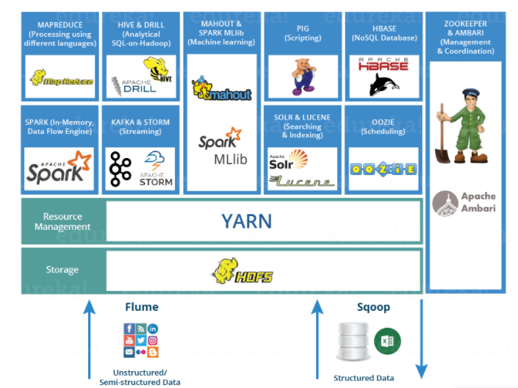
What is Ecosystem?

Slide 5
Hadoop Distributed File System
Stores different types of large data sets (ie. structured, unstructured and semi structured data)
HDFS creates a level of abstraction over the resources, from where we can see the whole HDFS as a single unit
Stores data across various nodes and maintains the log file about the stored data (metadata)
HDFS has two core components, i.e. NameNode and DataNode

Slide 6
YARN
Performs all your processing activities by allocating resources and scheduling tasks
Two services: Resource Manager and NodeManager
Resource Manager: Manages resources and schedule applications running on top of YARN
Node Manager: Manages containers and monitors resource utilization in each container

Slide 7
MapReduce: Data Processing with Programming
Core component in a Hadoop Ecosystem for processing
Helps in writing applications that processes large data sets using distributed and parallel algorithms
In a MapReduce program, Map() and Reduce() are two functions
Map function performs actions like filtering, grouping and sorting
Reduce function aggregates and summarizes the result produced by map function

Slide 8
Apache Pig: Data Processing with SQL
Pig is a SQL like language used for querying and analyzing data stored in HDFS
Developed by Yahoo researchers, targeted mainly towards non-programmers
PIG has two parts: Pig Latin, the language and the pig runtime, for the execution environment
1 line of pig latin = approx. 100 lines of Map-Reduce job
The compiler internally converts pig latin to MapReduce
It gives you a platform for building data flow for ETL (Extract, Transform and Load)
PIG first loads the data, then performs various functions like grouping, filtering, joining, sorting, etc. and finally dumps the data on the screen or stores in HDFS.

Slide 9
Hive: Data Processing with SQL
Uses SQL to facilitate the reading, writing, and management of large datasets residing in HDFS
A data warehousing component which analyses data sets in a distributed environment using SQL-like interface
The query language of Hive is called Hive Query Language(HQL)
2 basic components: Hive Command Line and JDBC/ODBC driver
Supports user defined functions (UDF) to accomplish specific needs

Slide 10
Mahout: Machine Learning
Provides an environment for creating machine learning applications
It performs collaborative filtering, clustering and classification
Provides a command line to invoke various algorithms.
It has a predefined set of library which already contains different inbuilt algorithms for different use cases

Slide 11
Spark: In Memory Data Processing
A framework for real time data analytics in a distributed computing environment.
Written in Scala and was originally developed at the University of California, Berkeley.
It executes in-memory computations to increase speed of data processing over Map-Reduce.
100x faster than Hadoop for large scale data processing by exploiting in-memory computations

Slide 12
Hbase: NoSQL Database
An open source, non-relational distributed database - a NoSQL database
Supports all types of data and that is why, it's capable of handling anything and everything
It is modelled after Google's Big Table
It gives us a fault tolerant way of storing sparse data It is written in Java

Slide 13
Apache Drill
An open source application which works with distributed environment to analyze large data sets
Follows the ANSI SQL Supports different kinds NoSQL databases and file systems
For example: Azure Blob Storage, Google Cloud Storage, HBase, MongoDB, MapR-DB HDFS, MapR-FS, Amazon S3, Swift, NAS and local files
Combines a variety of data stores just by using a single query

Slide 15
References
Edureka
Simplilearn
Ref

